Slide 1




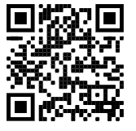
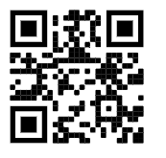
Darren Lutchner
linkedin.com/in/dlutchner
twitter.com/assist_365
Microsoft 365 and Power Platform Consultant
365 Assist - Solo consulting since 2020
Melbourne, Australia
5 Years developing Power Apps and Power Automate
Community Power Addict
Family man who likes good and bad Sc-Fi

Slide 2
Requirements
Replace 3rd Party timesheet application
Users to enter time for Activities (Projects, Support etc)
Report daily, weekly and monthly tasks by projects and user

Slide 3
Design decisions
Dataverse – Ability to manage large amounts of data and potential for data design growth.
Model Driven – Easy to establish for administration functions and simple reporting.
Canvas Apps – Catering for UI/UX requirements.

Slide 4
Demo

